Slide 1

How to
Avoid being Phished.
Mastercard IT & Security Team
28 November, 2024
Mastercard

Slide 2

Familiarize yourself with phishing attacks
According to our observations teams most at risk were:
1. HR
2. Marketing

Slide 3
HR Team Analytics for Phishing Campaign Nov2024
Average 87 %
HR
100%
HR
85%
HR
75%
Email Open Rate
Email Click-Through Rate
Phishing Rate

Slide 4
Marketing Team Analytics Phishing Campaign Nov2024
Average 48 %
MKT
65%
MKT
40%
MKT
38%
Email Open Rate
Email Click-Through Rate
Phishing Rate

Slide 5
About Phishing Attacks
Understand what phishing attacks are and how they can affect you as well as the organisation you work for.

Slide 6
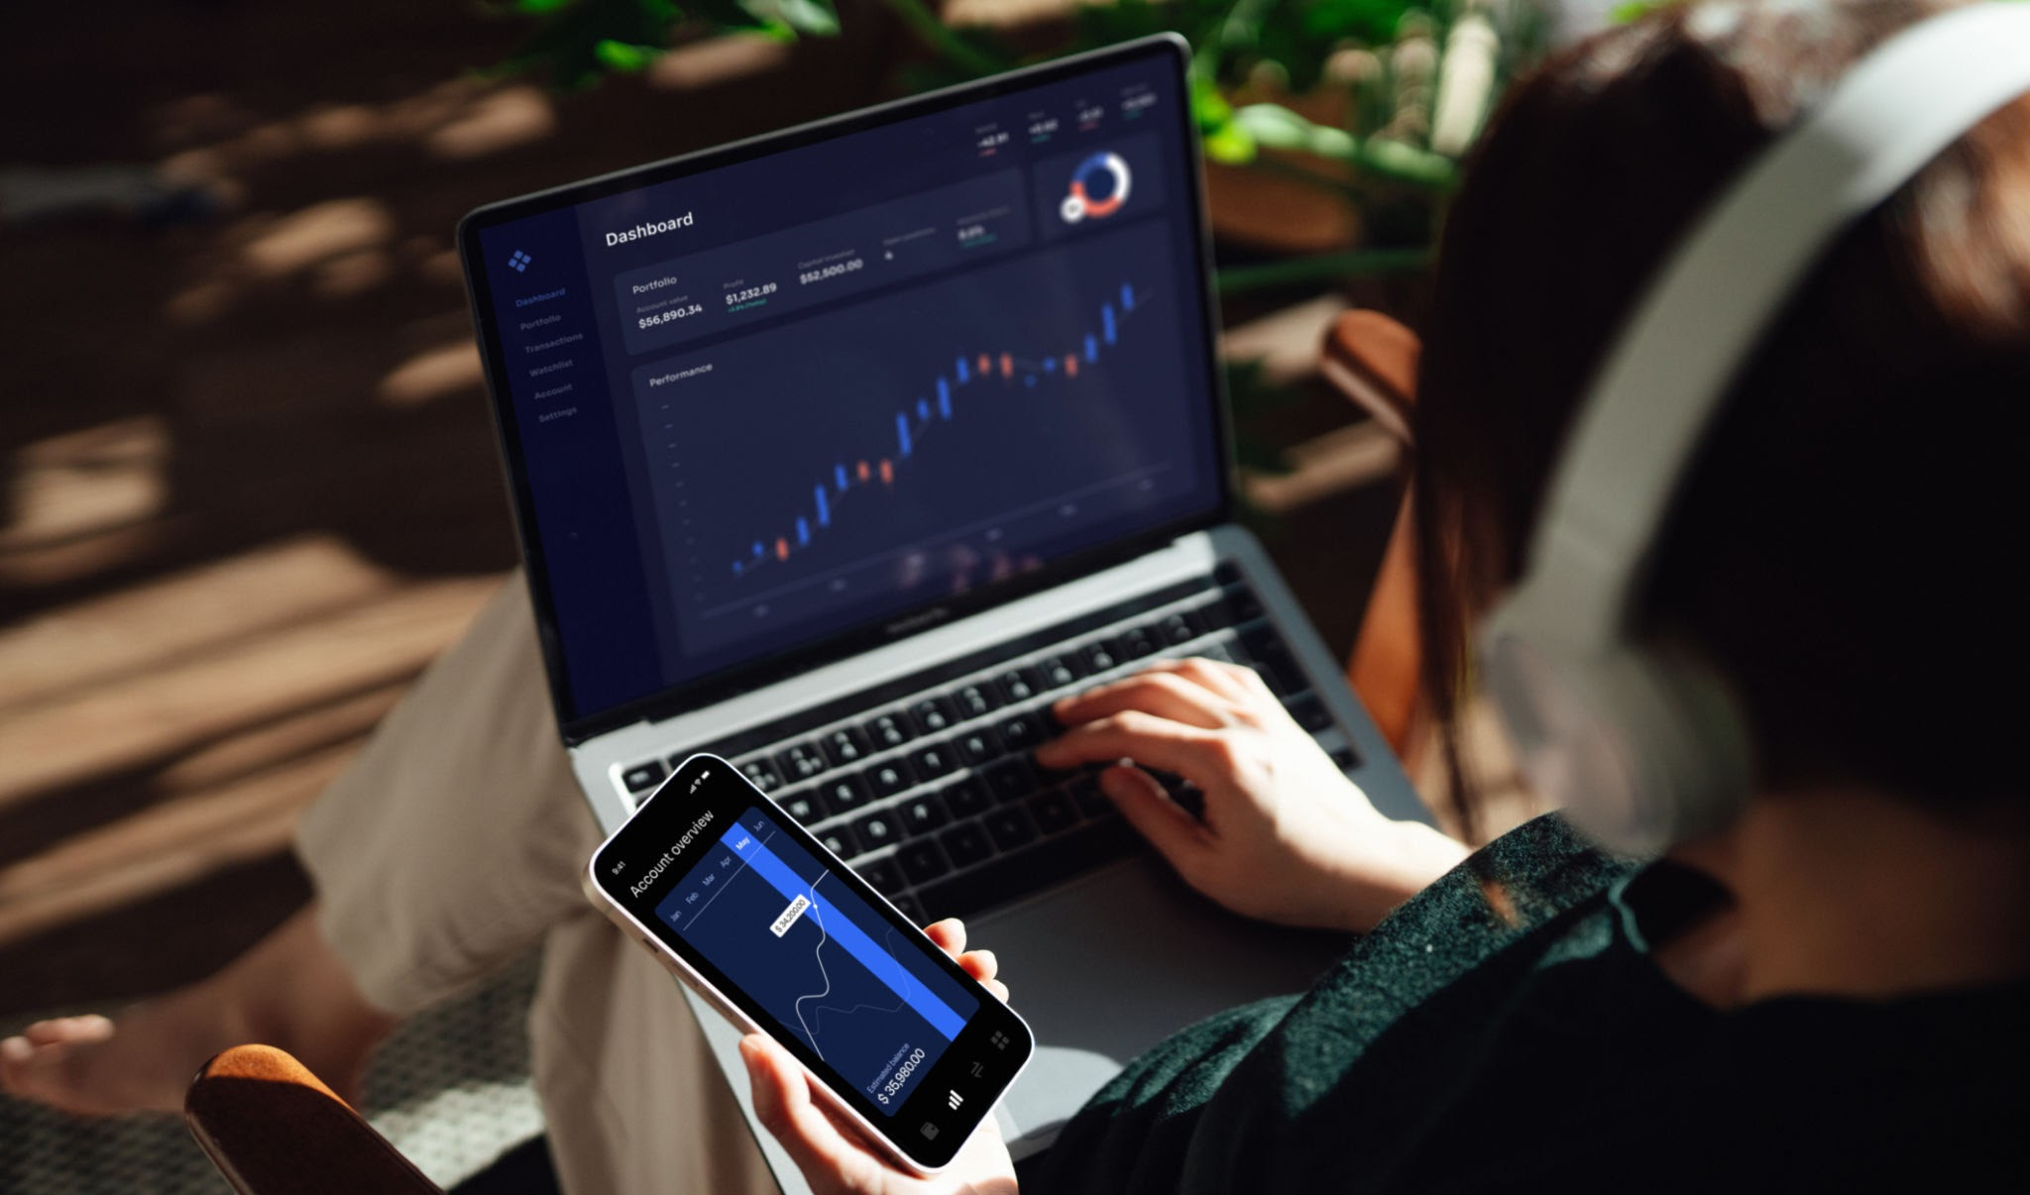

What is Phishing?
Phishing is a type of cyber attack wherein threat actors will trick you into submitting passwords, download files or even visit certain links.
All this is for the sole purpose of harm. Either getting a password to breach into our systems or click certain malicious links to automatically download malicious files that can cause and have throughout history shown to cause devastating effects on an organisation.
They often look like they’re coming from a trusted source.

Slide 7

Why you should care.
Financial Loss: Threat actors may gain access to your personal or company’s financial credential and cause financial losses.
Data Breach: After gaining access due to you clicking a link, can give them remote access to all confidential files.
Identity Theft: Threat actor can use your information to impersonate you.
Company Compromise: After gaining access they can get most company data.

Slide 8
Learn to spot Phishing Emails
Get a deep dive into what you should be looking for.

Slide 9
Here’s what you need to be looking for.
Unfamiliar Emails
Deep Check Email
Urgent Language
Check for address not coming from registered domains.
Remember that an ‘a’ is different from an ‘ɑ’. Look out for these.
The bad guys are always in a hurry, but you need to relax and look well!
Weird Links
Attachments
Show Relations
Paste URL carefully in virustotal.com to check for malicious behaviour.
Don’t open unexpected or suspicious attachments. Seek manager if needed.
The bad guys love pretending to be from the other side of the office, they’re from the other side of the world!

Slide 10
What to do if you spot/doubt a Phishing Email
Seek help immediately!

Slide 11
What to do if you spot or doubt a Phishing Email?
It’s better to be falsely wrong than actually wrong :)
Do Not Click
Verify Source
Report Immediately
Make sure you don’t click on the links.
Contact organisation directly through official channels to consult.
Report it to the IT and Security Teams ASAP.
Delete Email
After sharing with IT and Security Teams delete it to avoid accidental opens.

Slide 12
Thanks!
Watch out :)
IT & Security Team

